Slide 1
HKUST Green Mobile App
2013-2014 FYP MU4
Chan Wai Yu , Candy
Chung Kit Wai, Miffy
Pang Wing Chau,Terry
Wong Kin Yee, Phoebe
20035685
20109436
20056859
20013625

Slide 2
Introduction

Slide 3
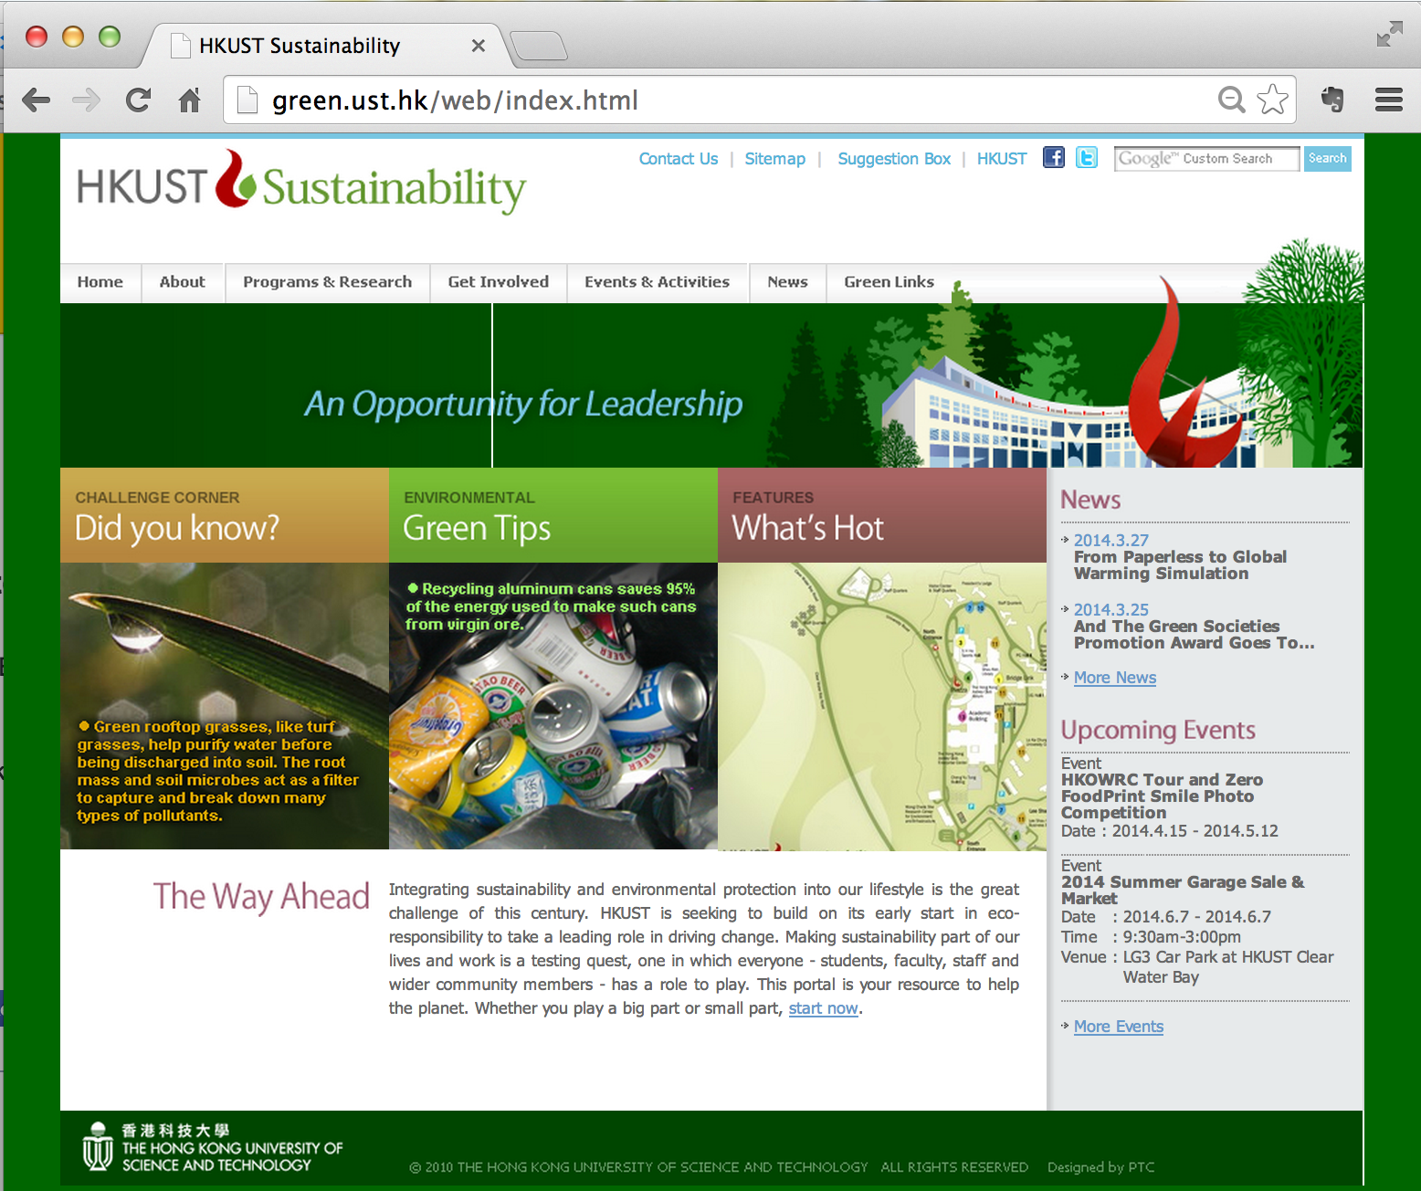
Project Initiation
Set up in 2012
aims to educate and influence the HKUST community to develop a better understanding of issues in energy conservation, recycling, waste minimization and pollution prevention

Slide 4
The PROBLEM We Intend To Solve
☹ Lack of motivation to study the textual content on the official website in detail

Slide 5
Objective
Cross Platform
App Support
Automatic
Content Integration
Increase green awareness

Slide 6
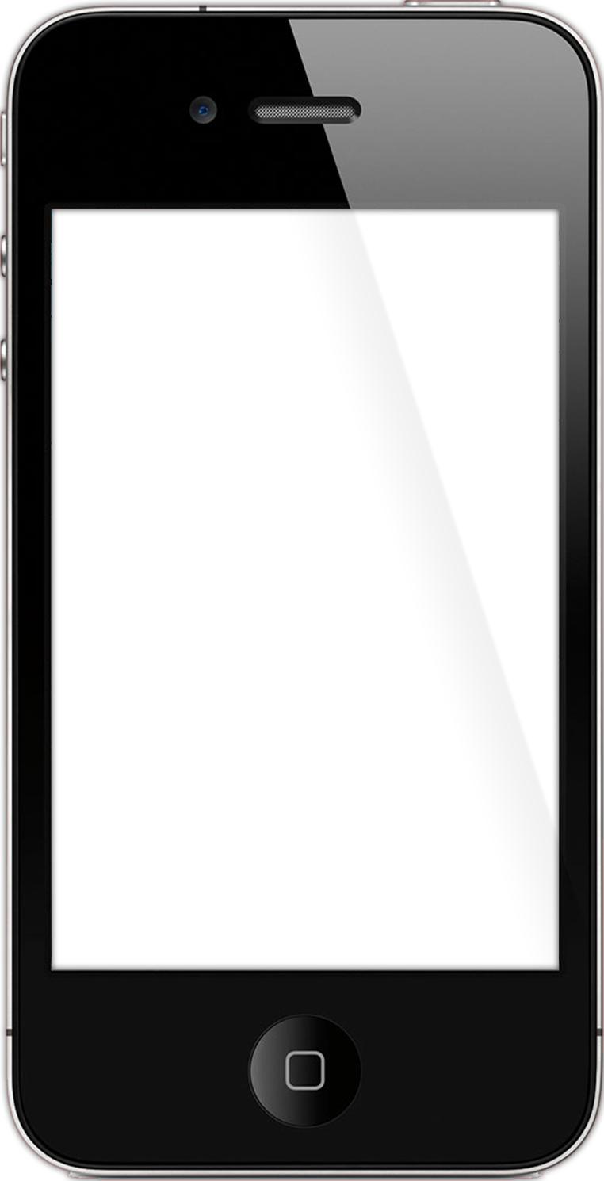
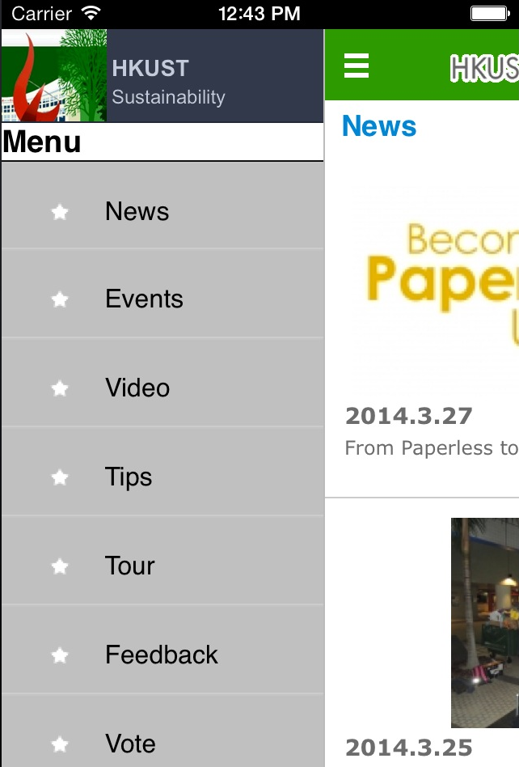
Cross Platform Support

Slide 7
Supported features
Events
News
Voting
Tips
About Us
Feedback
Green Tour
Map
Green Channel

Slide 8
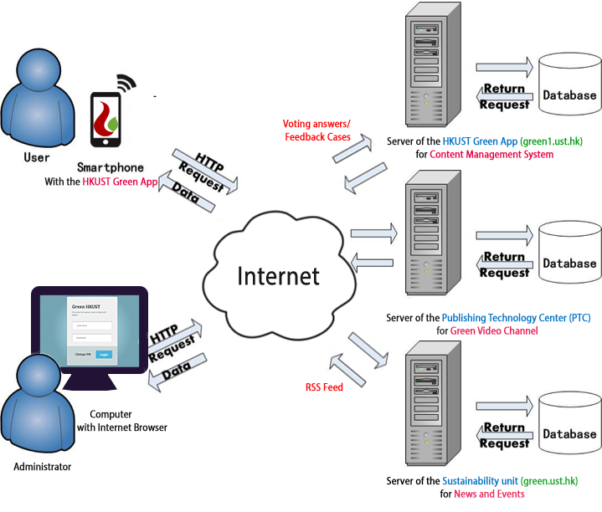
System Network Design
Figure 2.3.1 Diagram of workflow between the mobile device and the database

Slide 9
Features

Slide 10
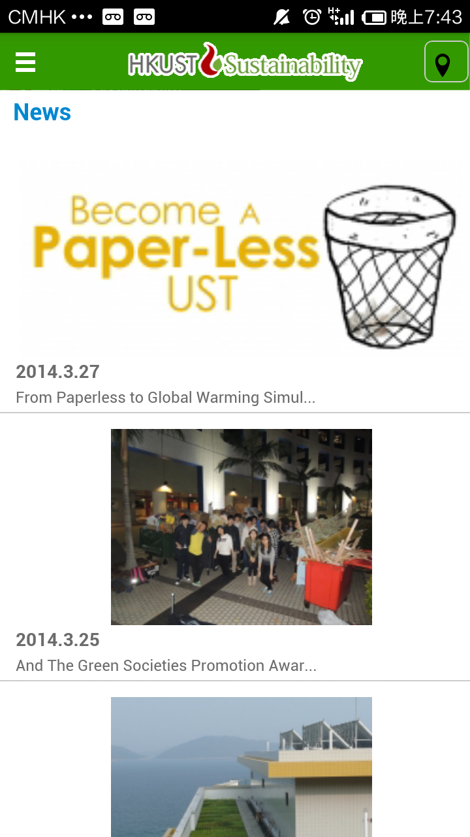
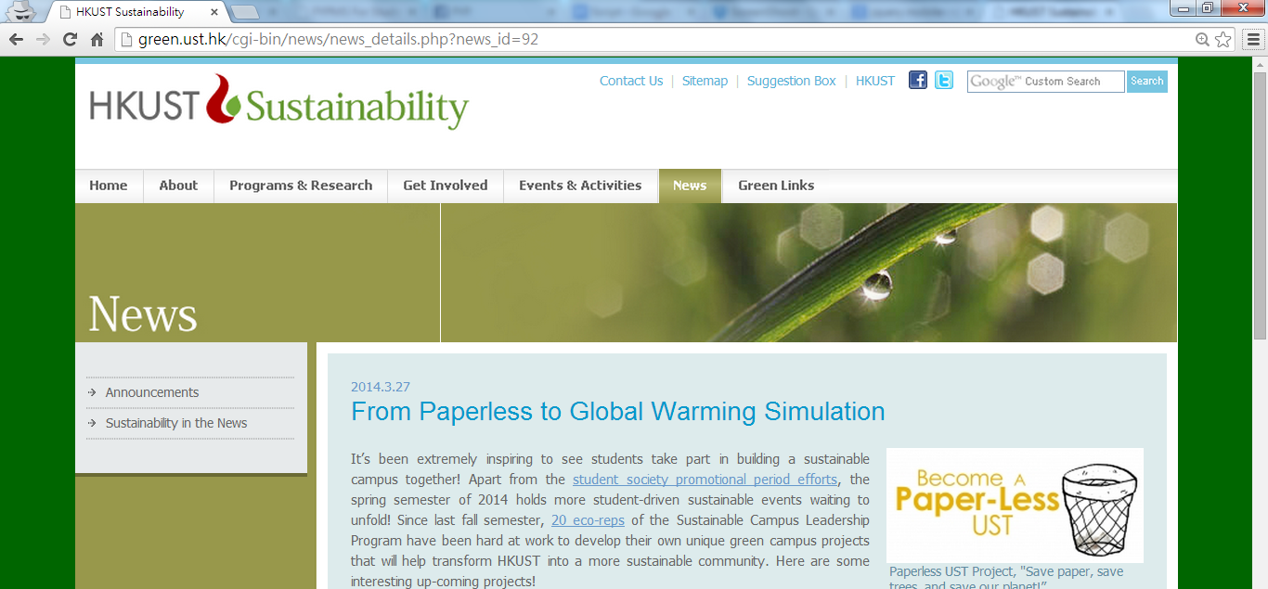
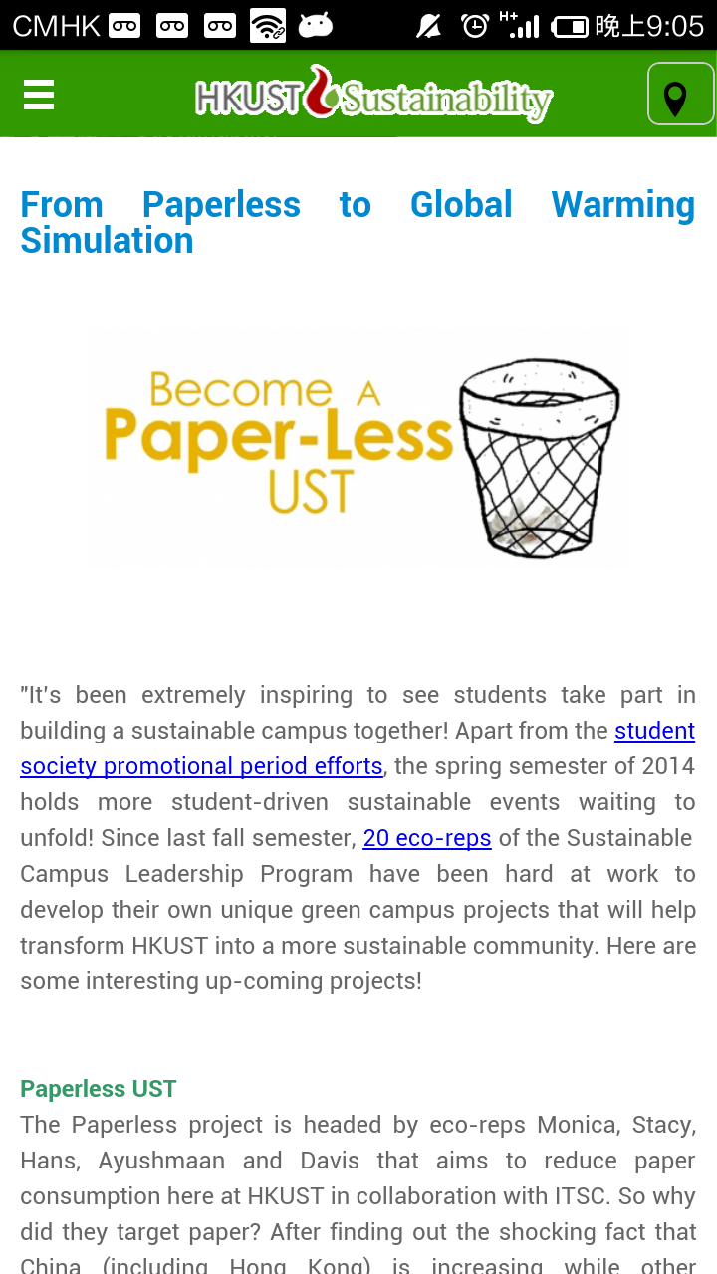
Feature 1 - News and Events
Fetch content from RSS feed
App content is synchronized with the sustainability website

Slide 11
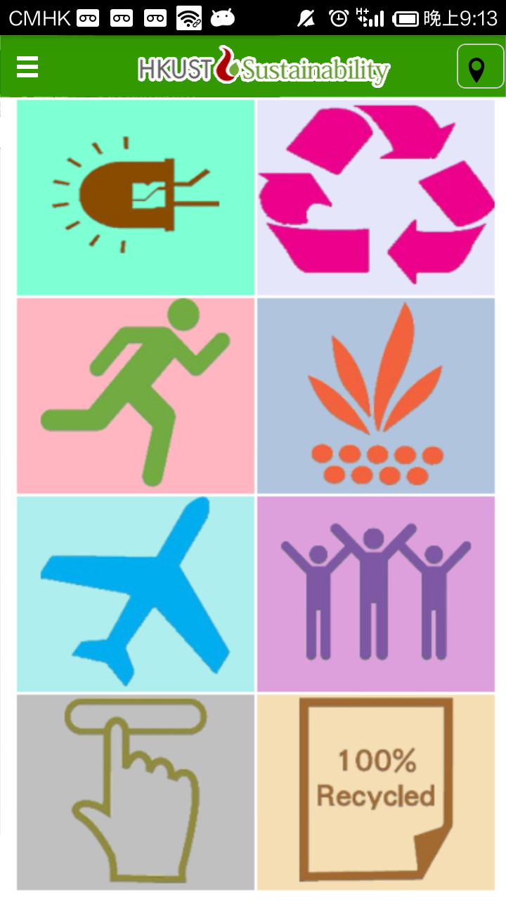
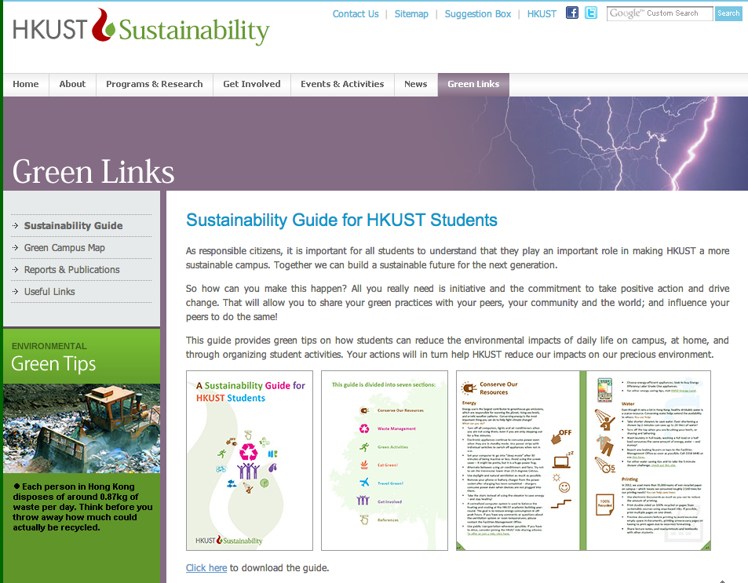
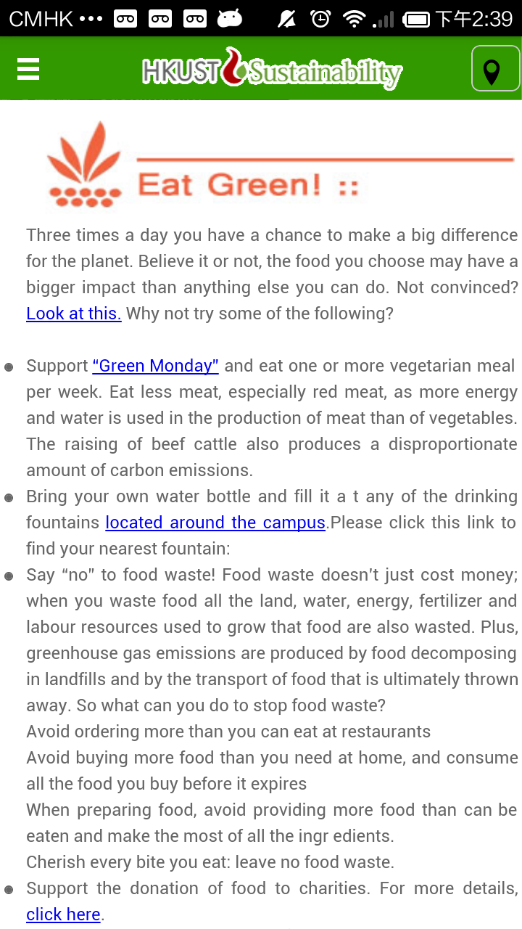
Feature 2 - Green Tips
Extract Green Tips from Sustainability Guide
Divided into 8 categories.

Slide 12
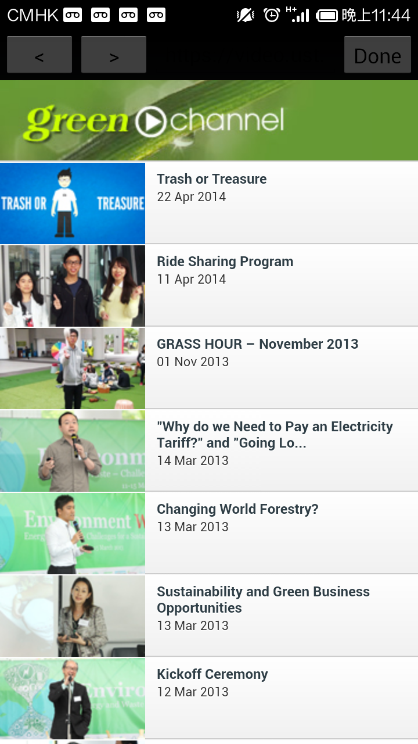
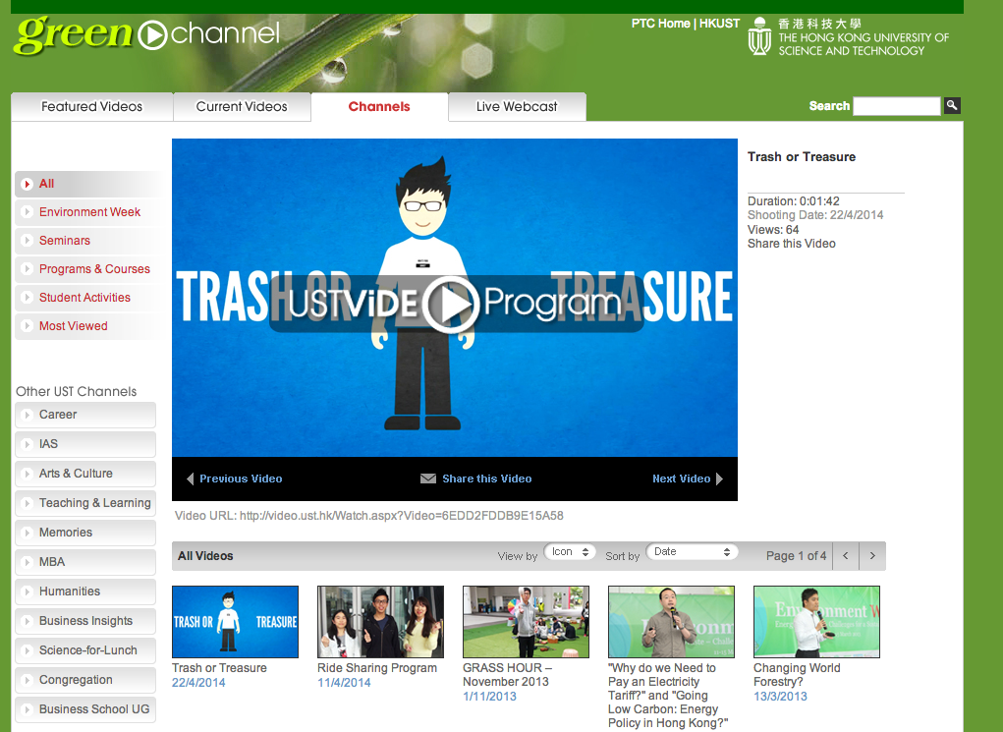
Feature 3 - Video
Display Videos from Green Channel Page from PTC.

Slide 13
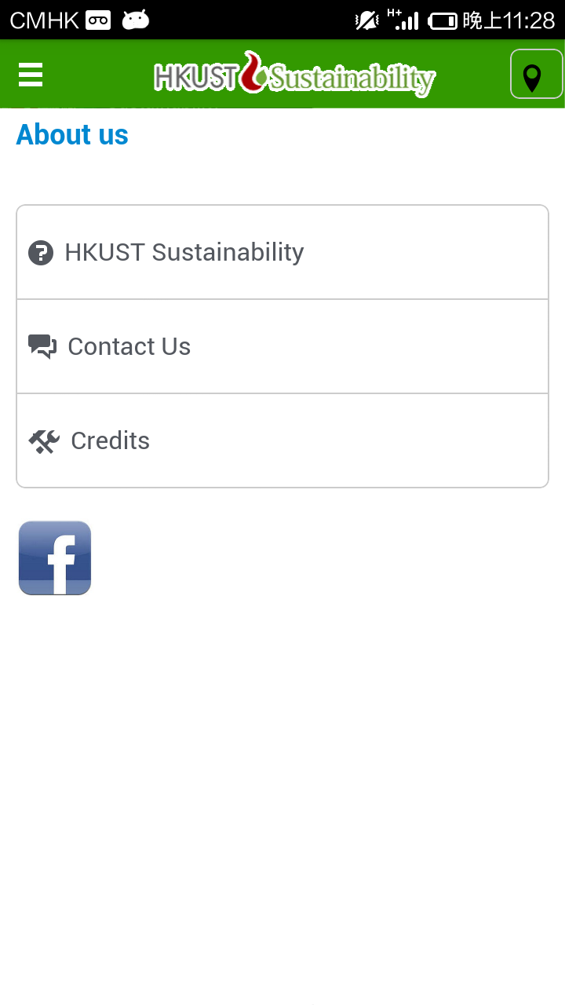
Feature 4 – About Us
Introduces Sustainability Unit and provides contact information

Slide 14
What’s More?

Slide 15
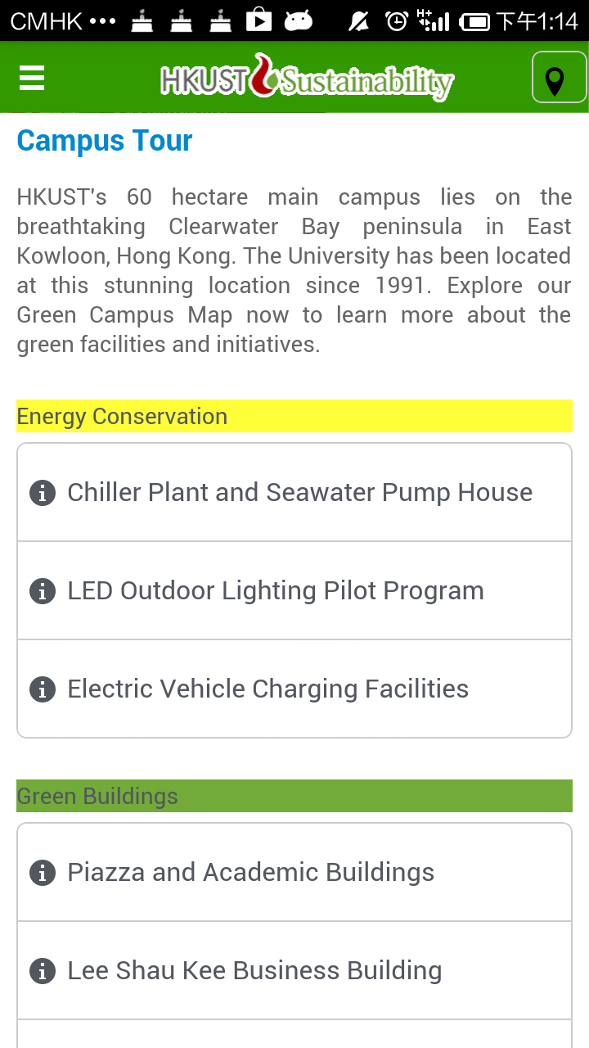
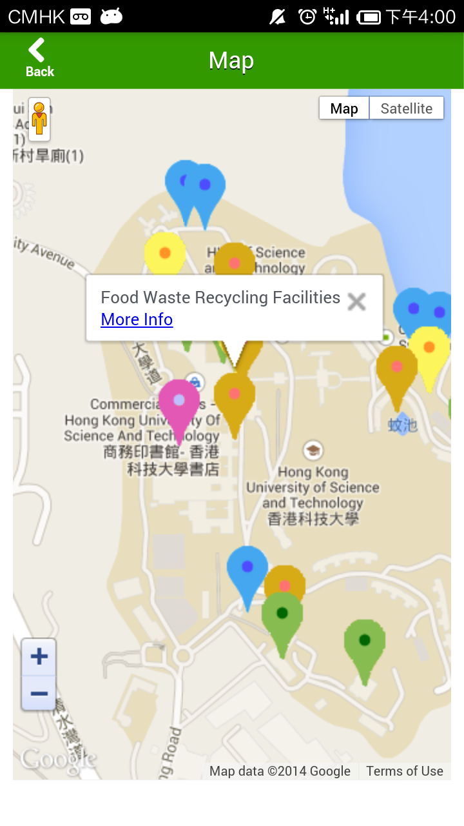
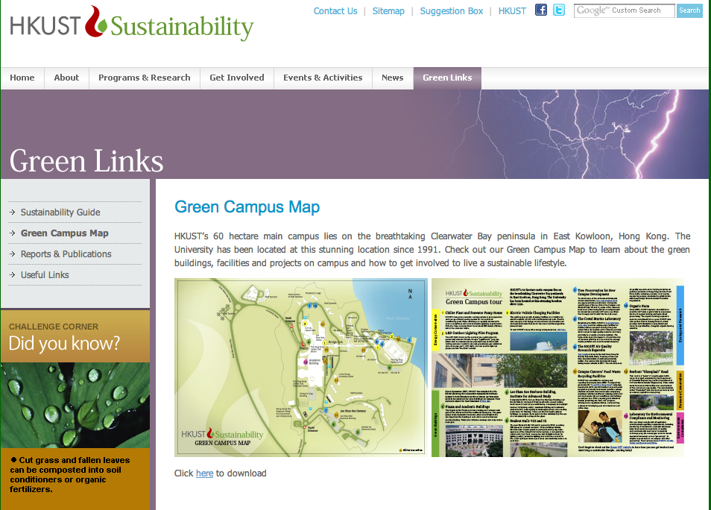
Feature 5 - Green Tour
Extract Green Tour Spots
Presents Green Tour Spots listed in Green Campus Map using Google Map API

Slide 16
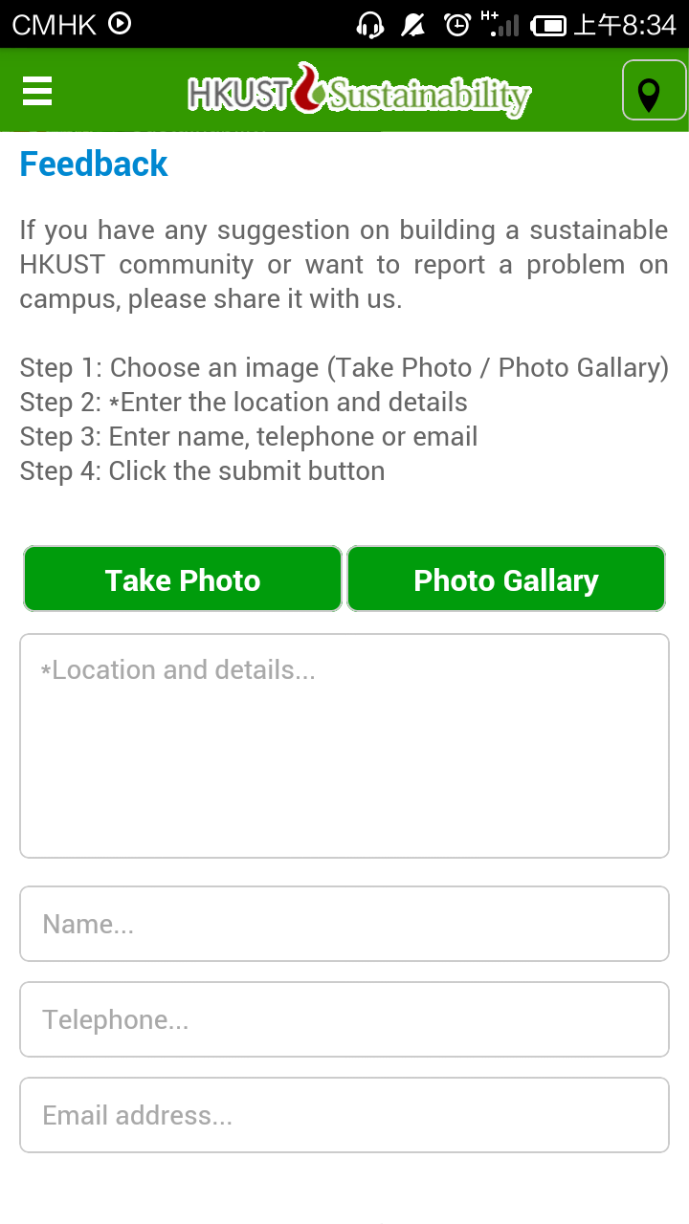
Feature 6 – Feedback
Allow users to report any cases related to sustainability around the campus

Slide 17
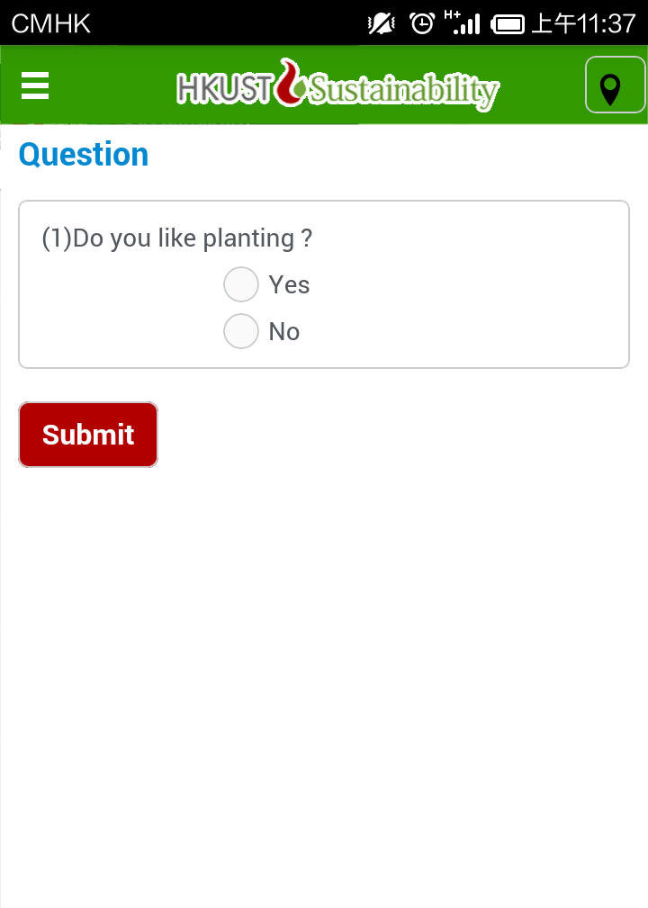
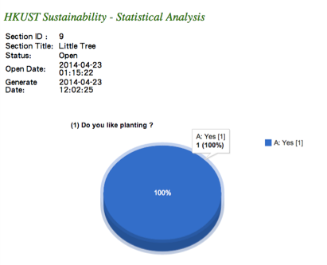
Feature 7 – Vote
Students or guests could cast their vote on discussion of the green issues
The statistics could be presented in chart
Raw data can be exported as Excel

Slide 18
Implementation

Slide 19
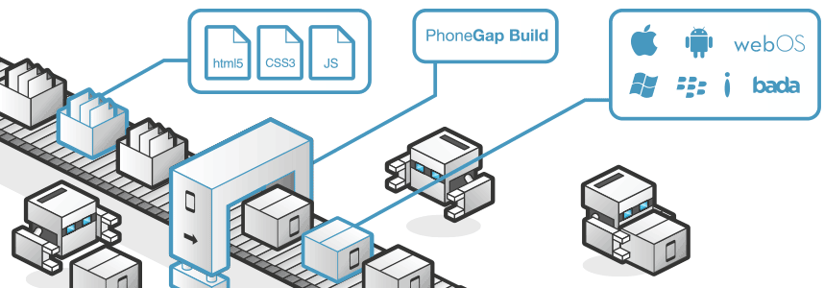
Implementation 1 - Technology
UI: HTML5 +
X jQuery Mobile: slow view transition
Multi-platform: Phonegap
✔Access native device APIs (e.g. Camera)
Intel’s App framework

Slide 20
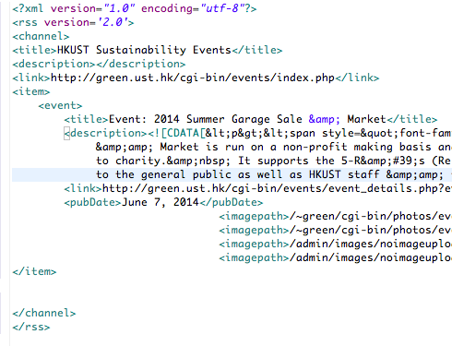
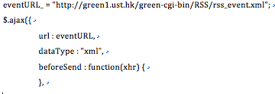
Implementation 2 – News & Events
Ajax
(Asynchronous JavaScript and XML)
Returned Data in XML format
Http Request
Data

Slide 21
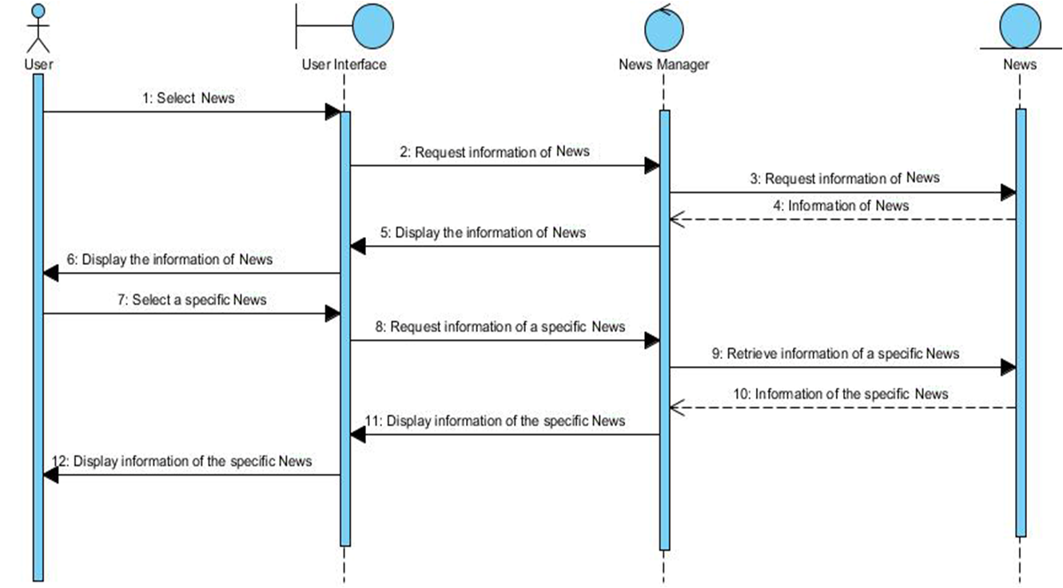
Implementation 2 – News & Events
Sequence Diagram of News & Events

Slide 22
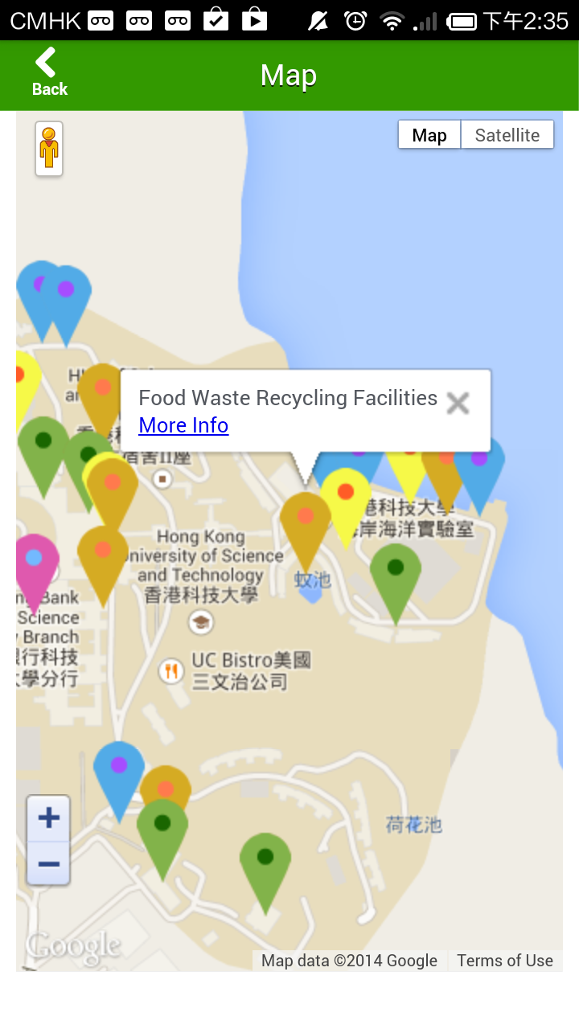
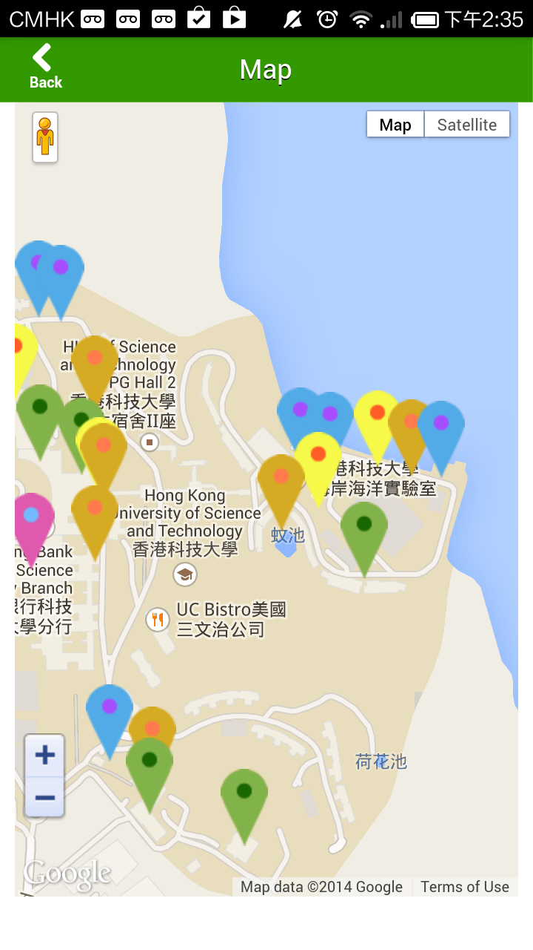
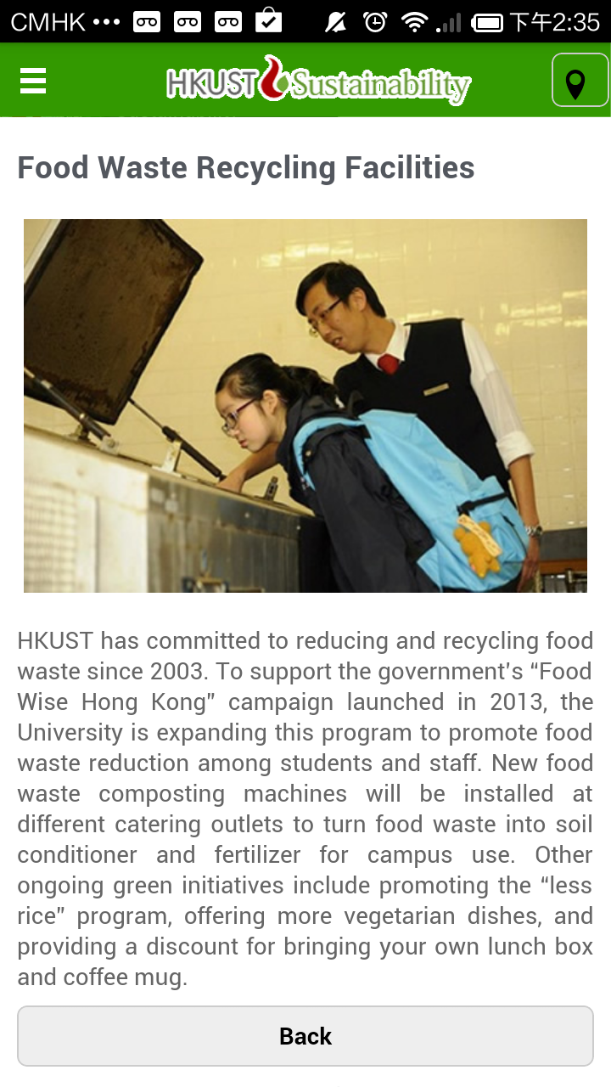
Implementation 3 – Green Tour Map
Define a marker
Define a pop-up window

Slide 23
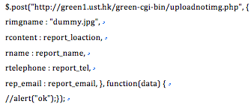
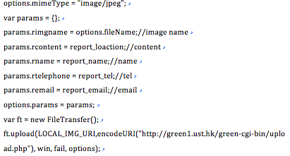
Implementation 4 – Feedback
Submission Without Photo
Submission with Photo

Slide 24
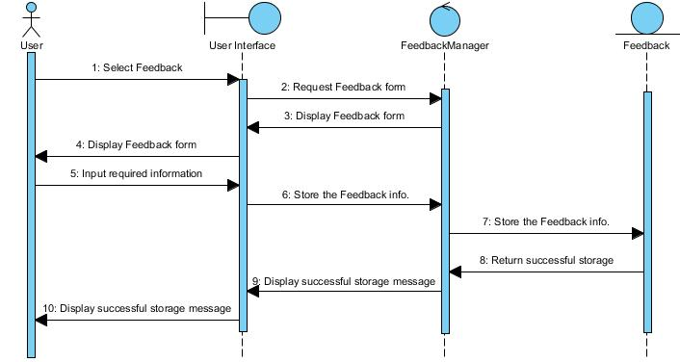
Implementation 4 – Feedback
Sequence Diagram of Feedback

Slide 25
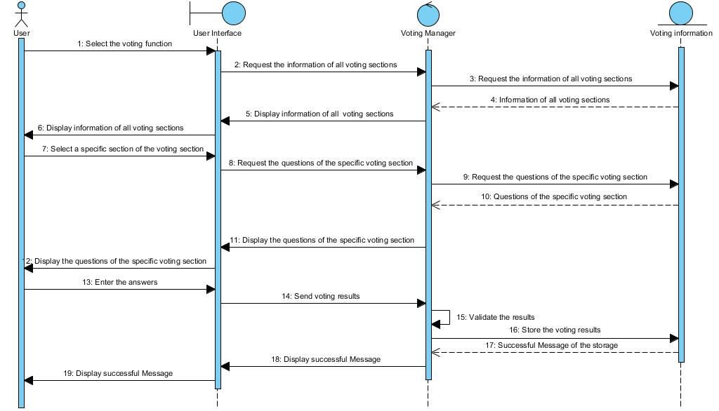
Implementation 5 – Voting
Sequence Diagram of Voting

Slide 26
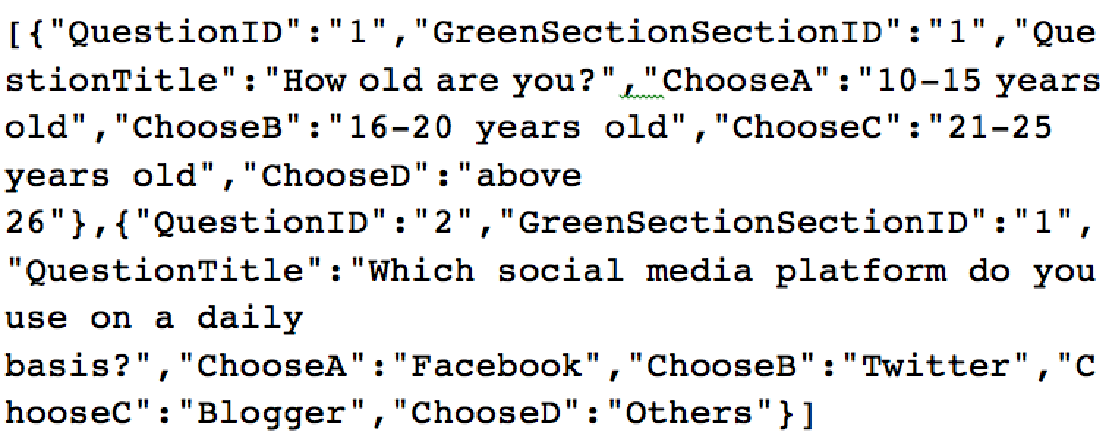
Implementation 5 – Voting(Generate Question)
JSON of
Voting question
✔JSON: flexible & light
Entity Relation Diagram
JSON of voting questions in a particular voting session

Slide 27
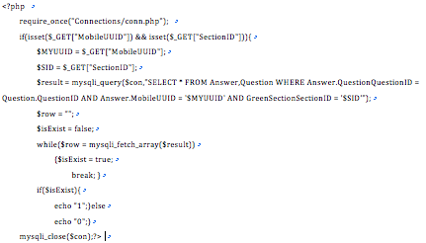
Implementation 5 – Voting(Submit Answer)
Code segment of validating submission

Slide 28
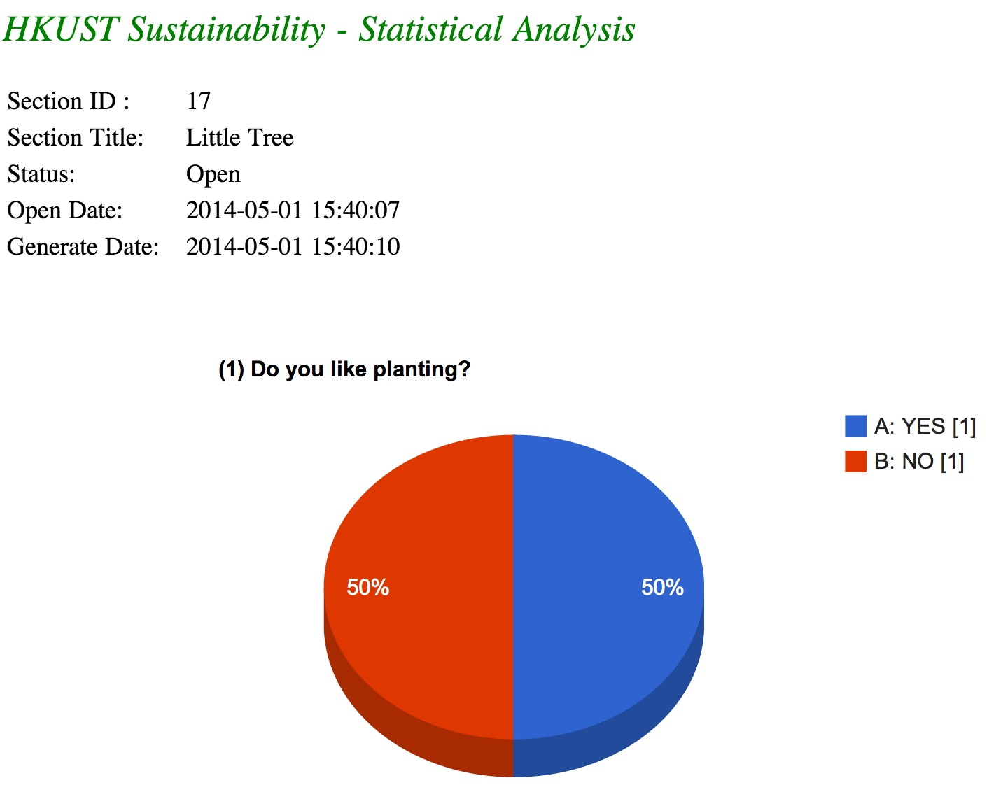
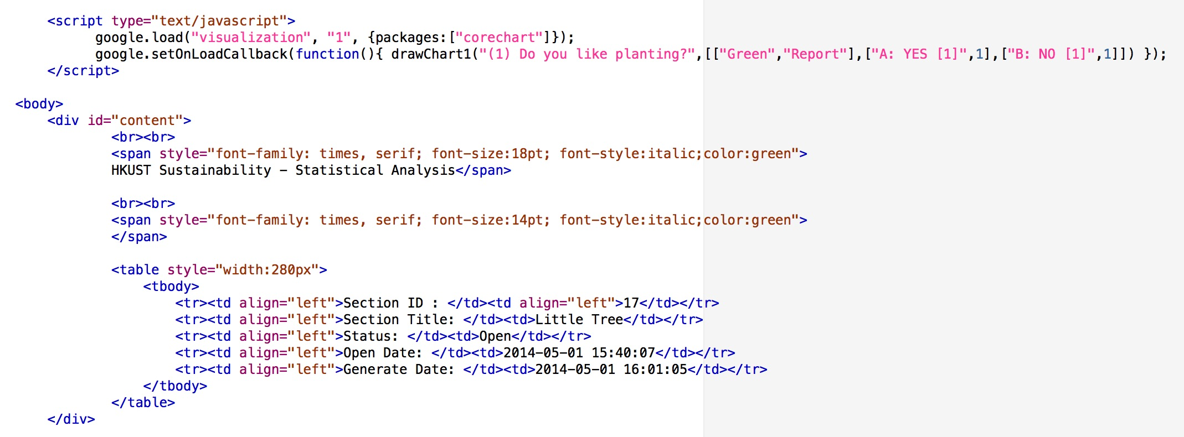
Implementation 5 – Voting (View Chart)
Google Chart API
Code Segment of Statistic Page (1)

Slide 29
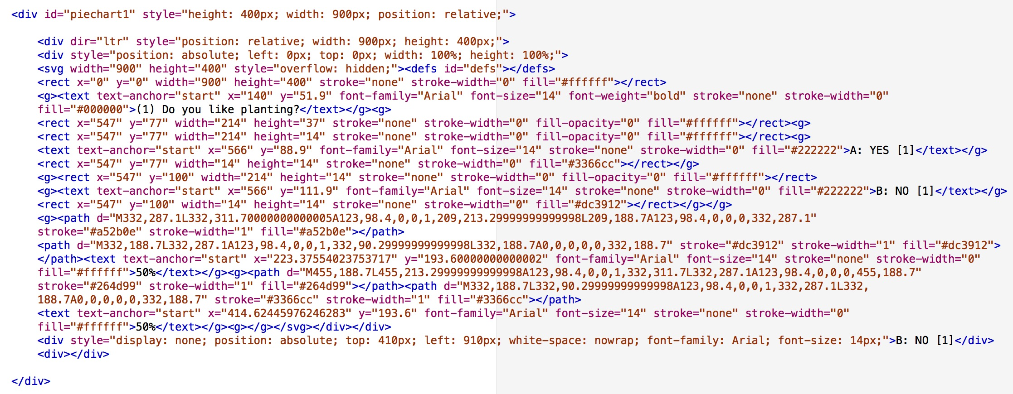
Implementation 5 – Voting (View Chart)
Code Segment of Statistic Page (2)

Slide 30
Demonstration

Slide 31
Conclusion

Slide 32
Q&A

Slide 33
Future
Enhancement

Slide 34
Feature 2 - Green Tips
Learn→Act
Start a Green Challenge

Slide 35
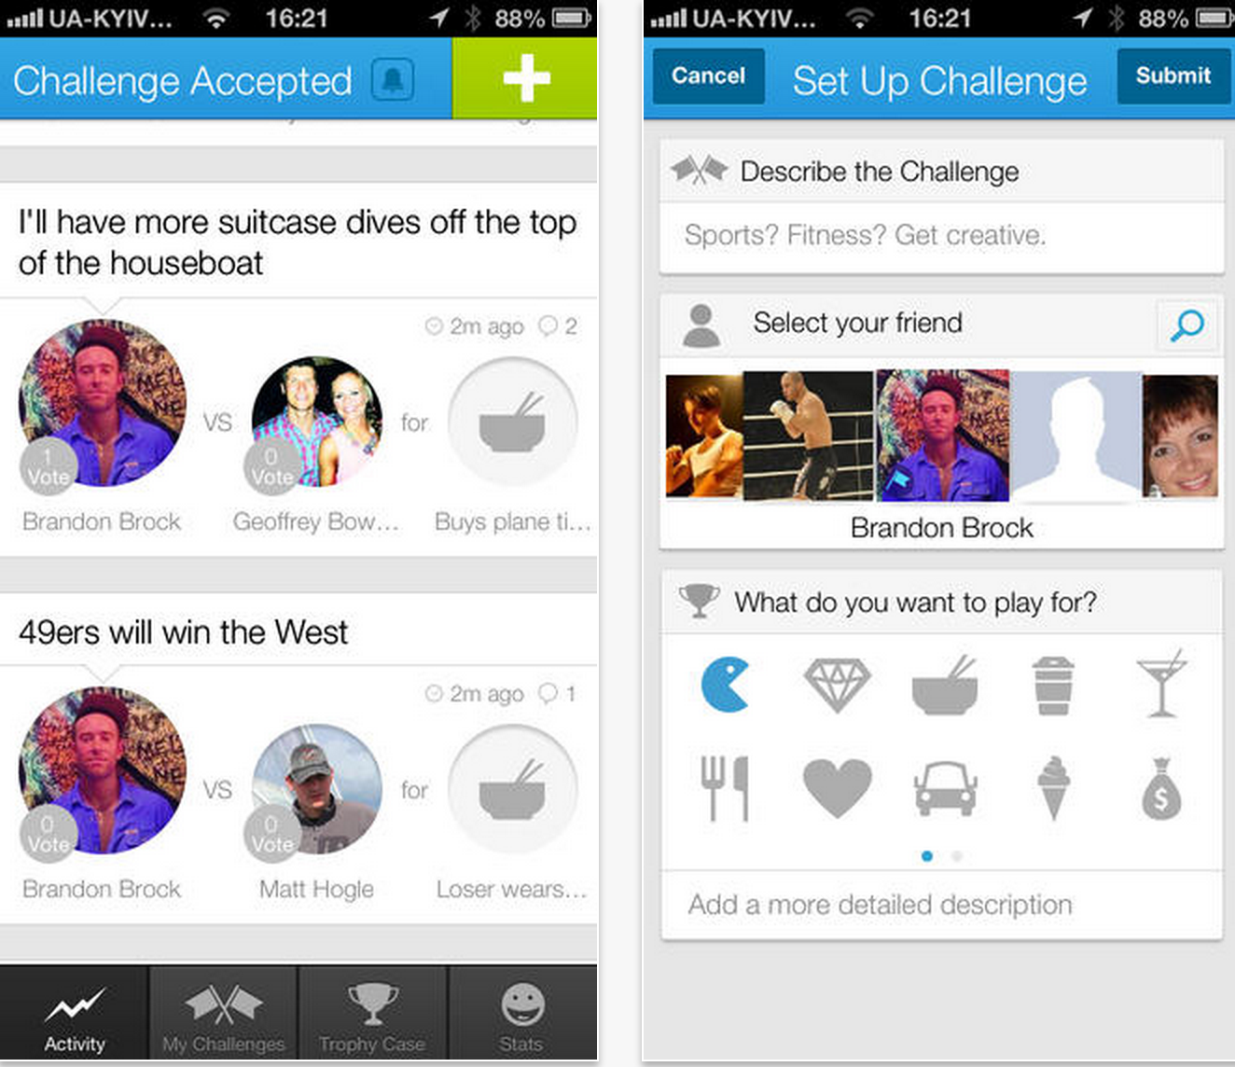
Feature 8 - Green Challenges
I’ll finish all my lunch and leave no food waste
I walk to my 5/F classroom without taking elevator
Concept adopted from the App “Challenge Accepted”

Slide 36
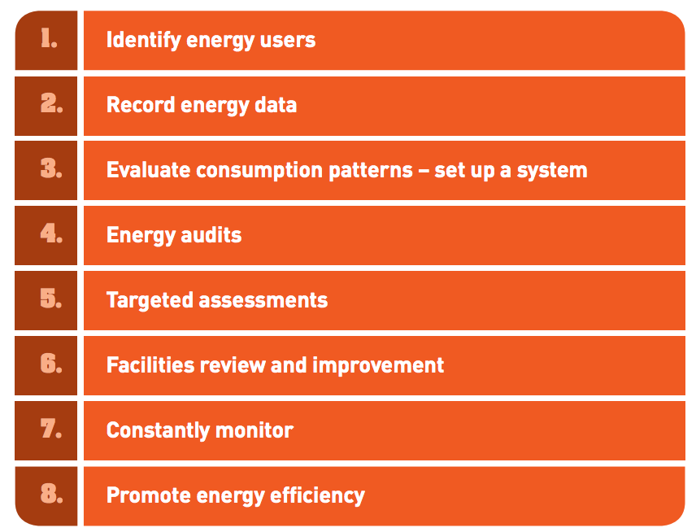
Feature 6 – Feedback
What are the follow-up actions can be done?

Slide 37
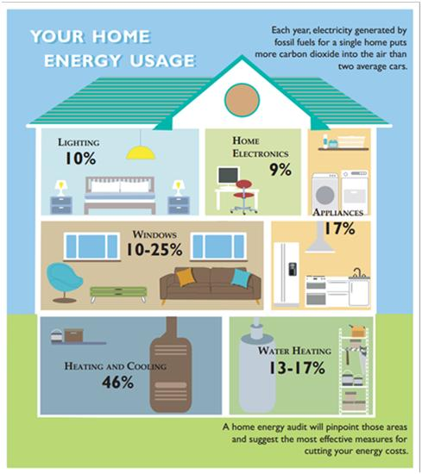
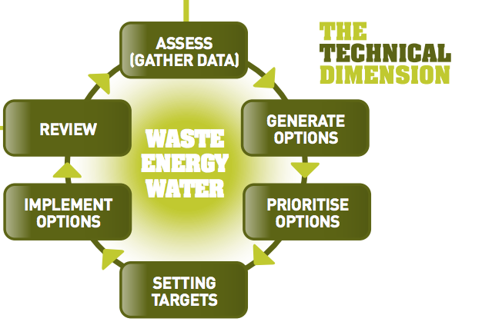
Feature 9 – Campus Green Meter
To see what everyone of us can do more
Shared Sustainability Goal
Visualized Saving Benefits

Slide 38
Evaluation

Slide 39
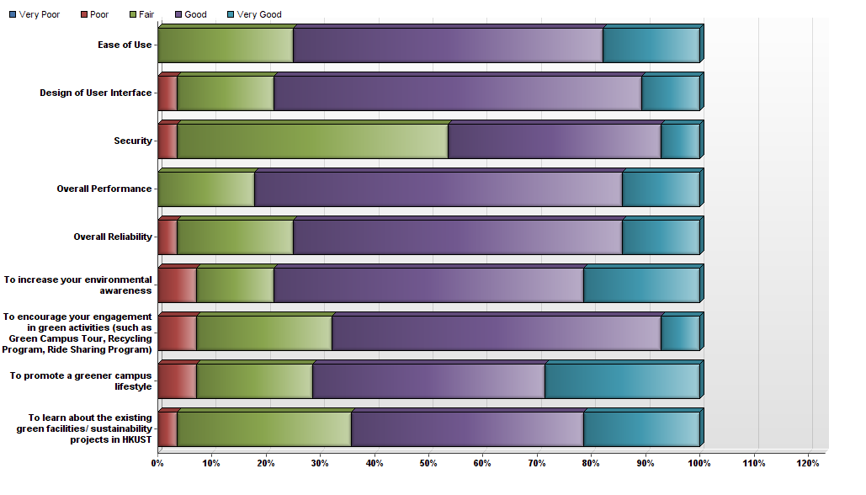
The effectiveness of increasing environmental awareness

Slide 40
Performance
Reliability
Successful error handling
Security
No sensitive information
Scalability
Separated servers
User Experience
User Acceptance Test

Slide 41
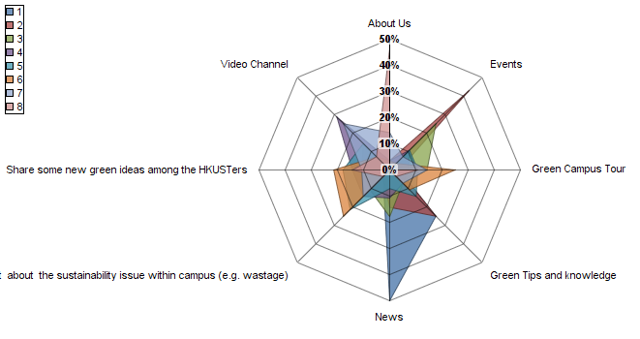
The features that are most important for the app. Please drag and drop to rank the following functionalities in order of the likelihood of you using them.
(rank 1 = highest)
Rank

Slide 42
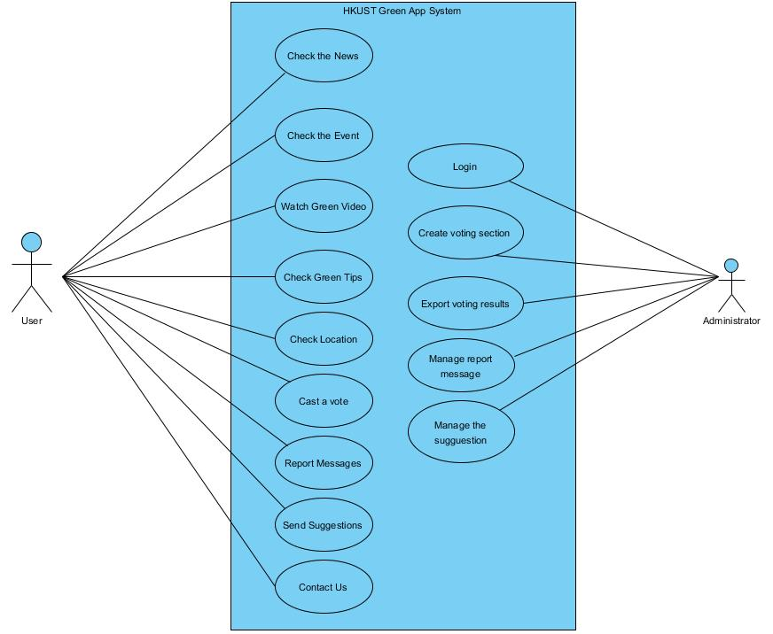
Use Case Diagram

